Slide 1
Complexity

Slide 2
Measuring Execution Time
10 minute oyster

Slide 3
Why Care about Execution Time?
Really, we have two limited resources: time and storage-capacity.
There is often a trade-off between the two.
E.g. There may be a faster algorithm that takes up more memory
But storage capacity is cheap and rarely a major issue these days
As data grows bigger, execution time can escalate.
An algorithm that retrieves information quickly on a single machine may be intolerably slow for a large web application
If execution time is really large (100’s of years) the problem is effectively unsolvable.
This is the idea behind many cryptographic protocols. If you knew how to factor products of large prime numbers, you could break a lot of encryptions, but the best known algorithms take centuries to do this.

Slide 4
Measuring Execution Time
The direct approach: check the time before an algorithm runs, and after it runs, and compute the difference <note to artist: picture of stopwatch>
But there are many factors that influence running time:
Processor/memory speed
Other processes on the same CPU
Operating system
Implementation language
Because hardware is always changing, we usually care about the order of magnitude of running time
Not important if one algorithm is twice as fast as another.

Slide 5
Measuring Execution Time 2
We’d like a way to compare algorithms, at the design stage, abstracting away from hardware, implementation, etc…
To do this, we can count elementary operations.
Some steps will be faster than others – but that’s not too important
Remember that we’re focusing on orders of magnitude
But each elementary operation must take the same amount of time each time it runs
Or at least the running time must be bounded by a constant
We can’t have one elementary step that takes longer and longer for large numbers, for example.

Slide 6

Counting Steps Example
We could count each primitive operation: constructing a range, assigning a variable to it
But let’s trust that each time control passes through a for or print statement, the time it takes is bounded by a constant. Then we can consider this an elementary operation.
Each time we go through the outer loop, the inner loop executes i times, totaling 2i steps.
For each of these, control passes through the outer for loop once, so the total number of steps is
1 + (1 + 2) + (1 + 4) + … + (1 + 2(n-1)) = n²
Notice that it grows with n
This one’s simple, but these functions can get rather complicated.
We’d like to compare these functions and say something about how big they can get when working with lots of data
we’ll see a way to do that in the next segments!

Slide 7
Big O Notation

Slide 8
The importance of growth rate
The execution time of an algorithm depends on many things, but especially the size of the input
In the world of big data, we’re talking about huge inputs.
You could specify the running time for a fixed dataset size…
But you may not know how big a dataset you’ll have
Or, the same algorithm might get applied to new datasets.
Or the dataset you’re using might get a lot bigger.
And the trend is towards bigger and bigger data.
So a key concern is how the algorithm scales,
How quickly it grows with growing input.

Slide 9
How do We Measure Growth Rates?
One way is to write down the number of steps as a function of the input size, say
f(n) = 2n² + n + 100
Often, this function will vary with what’s actually in the input
For example, if we want to sort a list of size n and the size is random, it will take a while
But if the list is almost sorted, the algorithm might run much faster.
Typically, we’ll focus on the worst-case running time when we write down the number of steps.
That’s often pretty important for developers. Even if the average running time is low, we don’t want one user to face a week-long wait time.
Another problem: Our function f looks pretty complicated, and it may be hard to compare these against each other.
But there are two simplifications that we can make to help us.

Slide 10
Lower-Order Terms
First, notice that the lower order terms get less and less important as n grows.
In fact, the percentage difference between f and 2n² shrinks to 0.
So our first simplification is we forget about the lower order terms, and say our function grows like 2n².
When n is… | 2n² is | n is | 100 is
1 | 2 | 1 | 100
10 | 200 | 10 | 100
1,000 | 2,000,000 | 1,000 | 100

Slide 11
Constant Factors
Second, we don’t really care about the 2 either.
For one thing, that’s not a huge difference – we could get a computer that’s twice as fast.
Also, our elementary steps may not take the same amount of time, so 2n² may not really be twice as fast as n².
But there’s a deeper mathematical reason as well:
There’s a theorem that says that you can always decrease the coefficient if you increase the lower order terms.
So the 2 actually isn’t meaningful.
Because of this, we drop the 2 and say f grows like n^{2.}

Slide 12
Big O Notation
Here’s the mathematical way to say what we just did:
Our function f is big O of g,
if there is a constant c and some integer n₀, such that
f(n) < c g(n) for all n > n₀.
So g becomes an upper bound on f. (up to a constant)
This may not be true for small n, but it eventually becomes true.
You can take this definition and show mathematically that lower order terms and constants don’t matter.
So O(2n² + n) is the same as O(n²)
That means that most algorithms we work with will fall into one of a few growth rate classes.
We’ll look at some of those in the next segment.

Slide 13
Common Growth Functions 1

Slide 14
Constant
Our first growth rate is O(1)
This means that an operation takes the same amount of time, no matter what the input is.
Of course, the constant may be large, and there are times when you need to worry about it.
It could be a cryptographic key exchange, and this will slow down communication
Some other famous O(1) algorithms:
Getting the first item in a list
As we’ll see, finding a value in an important data structure called a hash table.

Slide 15
Logarithmic
Now we’re on to O(log n)
This is the same whether we use the base 10 log or the natural log.
And it’s fast – every time we double our input, we just add a fixed number of steps. And we can double the input again and again to reach huge n
An exabyte dataset would have (about 10¹⁸) bytes, but the base 2 log is just 60.
This is so fast, that there’s not even time to look at every item in your input.
You have to selectively look at parts of your input
An example: finding an item in a sorted list (through binary search)
In general the input needs to have some structure to it that the algorithm can exploit.

Slide 16
Linear
Linear functions are O(n).
The running time increases proportionally to the input.
Double the input, double the running time
It might be that you have to examine every item in the input, but just once.
For example, find the maximum value in an unsorted data table.
Even with today’s huge datasets, this is generally quite fast.
Other examples:
Adding two big integers digit-by-digit.
Adding two vectors, multiplying a vector by a scalar
Inner products of vectors

Slide 17
N Log N
Now we’re up to O(N Log N)
These are algorithms that have to process their inputs more intensely than looking at every item.
Even though O(N Log N) is bigger than O(N), adding the extra Log N doesn’t really change much, and these are still considered fast algorithms
Remember that log N grows very slowly with N.
But they’re at the edge of what we consider fast.
Some examples of O(N Log N) algorithms:
Fast Fourier Transform
Find the longest increasing subsequence in a sequence

Slide 18
Common Growth Functions 2

Slide 19
Quadratic
Now we’re on to growth rates that begin to concern us as algorithm designers.
Our first one is O(n²).
This really gets infeasible for today’s big datasets
If you think about a dataset with a billion rows. N log₂ N is about 30 billion, but N² is a billion-billion, essentially 30 million times larger.
If the first algorithm takes a second, the second takes a year!
Quadratic algorithms often appear when we use nested loops.
Other examples:
multiplying big integers, digit-by-digit. Writing all pairs of a set.

Slide 20
Higher-Order Polynomials
O(Nª) where a>2.
These algorithms are increasingly inappropriate for large datasets.
In the literature, you see a few well-known cubic-time algorithms (not much for higher powers)
Some examples:
Computing a least squares regression
Inverting an NxN matrix
Nesting a quadratic-time algorithm inside another non-constant-time algorithm

Slide 21
P
All of the growth rates that we’ve looked at so far are bounded by some polynomial.
You can always choose a, so that any function we look at is O(Nª).
We can call them all polynomial-time algorithms
For a moment, instead of looking at the algorithm, let’s talk about the problem that it solves.
Computer scientists have a special term for problems that can be solved in polynomial time: P.
This is the P in the famous conjecture P=NP, but we’ll get back to that later
For now, just know that P represents a theoretical standard for easily-solvable problems

Slide 22
Exponential
So what about problems that aren’t in P?
The most important non-polynomial-time algorithms are exponential.
The most common ones are O(2^{N})
Interestingly, the exponential function grows faster than any polynomial – even n^{1,000,000,000}.
Some examples:
Our naïve recursive Fibonacci algorithm
The traveling salesman problem: What’s the shortest route between cities that begins and ends at the same city?
Theorem proving: given a set of axioms, does a theorem follow from them?
These are hard problems in computer science and a very active area of research.

Slide 23
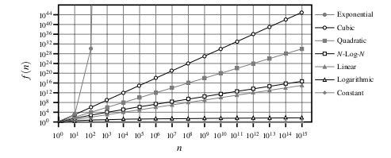
Comparison of Growth Rates
To summarize, we’ve seen 7 common growth functions.
You can see them on this plot, where both axes are logarithmic for clarity.
As you can see, they have a clear ordering, and it’s important to develop an intuition for how quickly each of these grows.
We’ll start applying these functions in the next segments
Source: Goodrich, Tamassia, Goldwasser

Slide 24
Insertion Sort

Slide 25
Why Study Sorting?
We’re about to apply our knowledge of functions to an important area of CS: sorting
Sorting is an important component of many systems, and complements many algorithms
For example, finding a value in an unsorted list is O(N)
But if you sort the list, you can use bisection search, which takes just O(log N).
To build many fast indexes, you need to sort.
It’s also a well-studied area and there are many algorithms to talk about. We’ll cover two of them.

Slide 26
Insertion Sort
Here’s an algorithm that’s fairly naïve. But it’s easy to understand and explain.
It’s described in the text in 5.5.2.
Basically, we’ll make sure the first 1 item is sorted (that’s easy)
Then we’ll put the second item in the right spot so the first two are sorted.
Then we’ll put the third item in the right spot so the first three are sorted.
And so on.
So after the nth step, the first n items are in the right order.

Slide 27
Insertion Sort Detail
(Look at the wikipedia page for insertion sort to see a nice animation)
Say the first 4 items are sorted and we’re up to the 5th:
Pull the 5th item out of order:
Then we start moving it left. 6 > 4, so we move the 6 one to the right.
Same with the 5.
3 < 4, so we’re done and we can reinsert the 4.
1 | 3 | 5 | 6 | 4 | 2 | 9
 |  |  |  | 4
1 | 3 | 5 | 6 |  | 2 | 9
 |  |  | 4
1 | 3 | 5 |  | 6 | 2 | 9
 |  | 4
1 | 3 |  | 5 | 6 | 2 | 9
1 | 3 | 4 | 5 | 6 | 2 | 9

Slide 28
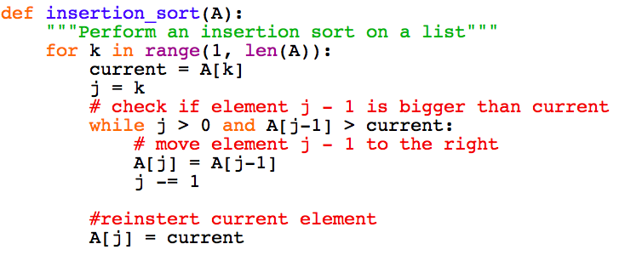
Insertion Sort in Python

Slide 29
Running Time of Insertion Sort
It turns out that we can usually count the number of comparisons to find the big O running time of a sorting algorithm
The number of steps per comparison is usually bounded.
The worst case is when each element moves as far as possible, all the way to the front of the list.
This actually happens if the list is in reverse order to begin with.
The element 2 requires 1 comparison, element 3 requires 2, and so on.
Total is 1 + 2 + … + (n-1) = n(n-1)/2.
This is O(n²)
In the next segment, we’ll see a better way to sort.

Slide 30
Merge Sort

Slide 31
Merge Sort
Now we’ll explore a more efficient way to sort
This is a good example for us for several reasons.
Merge sort is actually used in many production systems.
Python uses a variant of Merge sort (something called Tim-sort) to sort lists.
Merge sort can be expressed elegantly with recursion

Slide 32
Merge Sort Intuition
Central idea: if you have two lists that are sorted, you can combine them into one sorted list in linear time.
Look at the first element in both lists, and move the smaller element to the end of the combined list.
Repeat until both lists are empty
3 | 6 | 9
1 | 2
4 | 5 | 8 | 12
Now, we can use recursion.
So split a list in half, then run merge sort on each one
Finally, merge the two together.

Slide 33
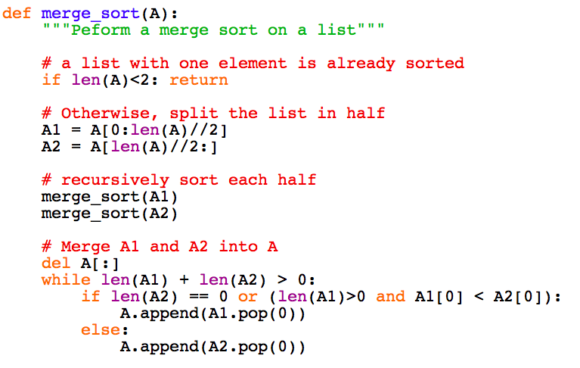
Merge Sort In Python

Slide 34
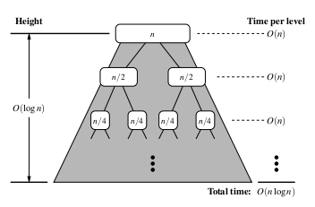
Running Time of Merge Sort
First, let’s compute the time it takes to sort at each level.
So just ignore the recursive merge_sort calls
Each time we move an item into the new list, we have one comparison, so total of O(N) comparisons
Therefore, we spend O(N) at the top recursion level.
At the second recursion level, we have two lists to sort, but each one is half as long, so takes half as much time to sort.
So the total time at this recursion level is the same, O(N)
The same hold true for each recursion level.
Finally, there are Log₂N recursion levels, so the total time is O(N log N).
This is the worst case time, and it’s much faster than insertion sort!
That’s a good reason the merge sort is a popular sorting option today
Source: Goodrich, Tamassia, Goldwasser

Slide 35
A Complexity Bound for Sorting

Slide 36
What’s the Fastest Possible Sort
Merge sort is O(N log N). Can we do any better than that?
Let’s figure out how fast an algorithm can run.
A good way to get a lower bound on sorting time is to count the number of comparisons we have to make.
Each of these takes constant time, so this works as a lower bound.
The sorting algorithm outputs a permutation of the sequence (a reordering)
There at n! possible permutations, and any one of these could be the correct sorted order.
If an algorithm only makes one comparison, it only branches once, and can only output one of two permutations.
So it can only sort a sequence with two elements!
So we need to figure out how many branches are needed to sort N items.
a₀,a₁,…,a_{n}
Sorted list

Slide 37
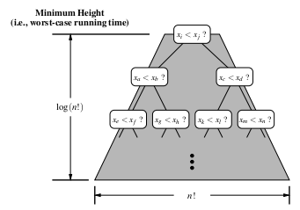
Decision Tree for Sorting
Let’s look at the decision tree for an algorithm.
Each time the algorithm makes a comparison, it branches in one of two ways.
Whenever it stops branching, the output is determined
So the number of leaves of the tree is the number of possible permutations.
And the height of the tree is the number of comparisons.
We need n! permutations, so the height must be log₂(n!)
In fact O(log n!) is the same as O(n log n)
You can check that n! is at least as big as (n/2)^{n/2}. So log n! is at least (n/2) log (n/2) and you can pull out the constant factors.
Source: Goodrich, Tamassia, Goldwasser

Slide 38
Fast Sorting
So the fastest we can sort is n log n.
There are a number of popular algorithms, merge sort, quick sort, etc that meet this bound.
A caveat: this assumes that we can only use comparisons to make our algorithm branch
If there is more structure to the space of items, it is sometimes possible to be faster.
For example, if we want to alphabetize words, or sort numbers within a given range, we can find better algorithms
But for the general case of a unstructured space of items, n log n is the important bound.

